Slide 1
Working with the Web Part Property Pane
Introducing the Property Pane

Slide 2

Introducing the Property Pane
Overview of Web Part property pane
Implementing custom properties

Slide 3
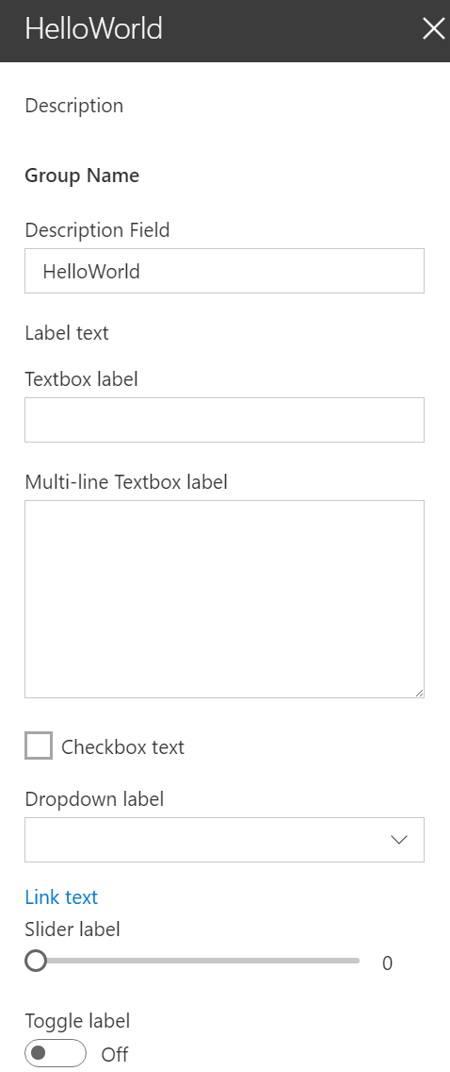
Overview
The property pane has three key elements
Pages, Headers, Groups
Property panes must contain a page and at least one group, the header is optional
The property pane supports the following field types
Label
Textbox
Multi-line Textbox
Checkbox
Dropdown
Link
Slider
Toggle
Custom
Notes:
Pages: Separate pages in a single property pane. Pages contain a Header and Groups.
Headers: The title of the property pane
Groups: Sections in the property pane that group properties

Slide 4
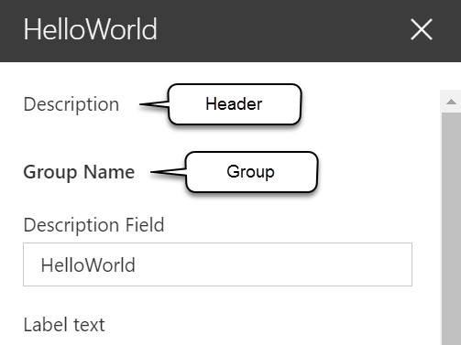
Implementing the header, groups, and fields
protected get getPropertyPaneConfiguration(): IPropertyPaneConfiguration {
return {
pages: [
{
header: {
description: strings.PropertyPaneDescription
},
groups: [
{
groupName: strings.BasicGroupName,
groupFields: [
PropertyPaneTextField('description', {
label: strings.DescriptionFieldLabel
}),
PropertyPaneLabel('labelField', {
text: 'Label text'
})
]
}
]
}
]
};
}

Slide 5
Implementing properties
Define an interface in your web part that includes one or more target properties
Import the corresponding field types in the web part class
Field types are available as modules in the @microsoft/sp-webpart-base library
Modify the default getPropertyPaneConfiguration method and add the properties to the groupFields array

Slide 6
Handling property field changes
The property pane has two interaction modes:
Reactive
Non-reactive
Reactive mode: every change = change event is triggered
Reactive behavior automatically updates the web part user interface with the new property field values
Non-reactive mode: does not update the web part user interface automatically unless the user confirms the changes
While reactive mode is sufficient for many scenarios, at times you will need non-reactive behavior.

Slide 7

Property pane modes
Default mode = reactive mode
Override the default behavior by adding the disableReactivePropertyChanges method to the web part class

Slide 8
Adding configuration properties to React Client-Side web parts
Modify the propertyPaneSettings method and add the property to the groupFields array
protected get propertyPaneSettings(): IPropertyPaneSettings {
return {
pages: [
{
header: {
description: strings.PropertyPaneDescription
},
groups: [
{
groupName: strings.BasicGroupName,
groupFields: [
PropertyPaneTextField('description', {
label: strings.DescriptionFieldLabel
}),

Slide 9
Adding configuration properties to React Client-Side web parts
Pass the property value to React component when the React component is created
public render(): void {
const element: React.ReactElement<IHelloWorldWebPartProps> = React.createElement(HelloWorldComponent, {
description: this.properties.description
});
ReactDom.render(element, this.domElement);
}

Slide 10
Adding configuration properties to React Client-Side web parts
Handle the property values in the React component when the component starts and whenever the property value is updated
public componentDidMount(): void {
this.doSomething(this.props.description);
}
public componentDidUpdate(prevProps: IHelloWorldWebPartProps, prevState: IHelloWorldWebPartState): void {
if (this.props.description !== prevProps.description) {
this.doSomething(this.props.description);
}
}
private doSomething(description: string): void {
// Do something with the property
}

Slide 11
Demo Working with the web part property pane

Slide 12

Summary
Overview of Web Part property pane
Implementing custom properties

Slide 13
Reading further
Overview of the SharePoint Framework
https://docs.microsoft.com/sharepoint/dev/spfx/sharepoint-framework-overview
Make your SharePoint client-side web part configurable
https://docs.microsoft.com/sharepoint/dev/spfx/web-parts/basics/integrate-with-property-pane
Validate Properties
https://docs.microsoft.com/sharepoint/dev/spfx/web-parts/guidance/validate-web-part-property-values

Slide 14
Thank you.

